Slide 1
Finance and the sources of growth Beck, T.H.L.; Levine, R.; Loayza, N.
Rohin Paul | Jordan Frimpong | Jonathan Owusu-Boadi | Andrew Cox

Slide 2
Contents
1. Relationship between Domestic credit and GDP per Capita (in ratio/log scales) for 2015. | 5. Results
2. Motivation | What is the channel through which financial development affects economic growth?
3. Research question | Discuss the causal relationship between financial development and economic growth.
4. Methodology

Slide 3
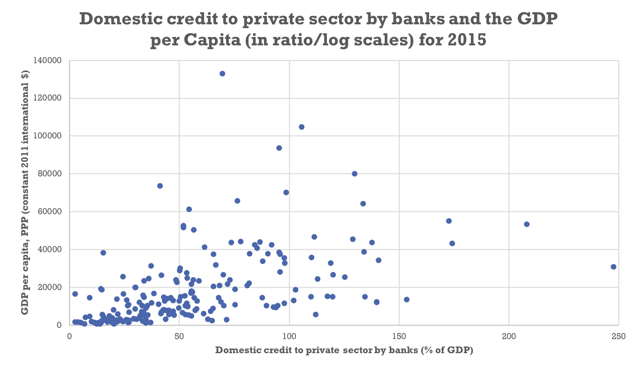
1. Relationship between Domestic credit and GDP per Capita (in ratio/log scales) for 2015
Low + middle income nations
High income nations
Heavily indebted poor nations
Less economically developed → More economically developed

Slide 4
Motivation
Joseph Schumpeter (1911) argued financial intermediaries played a pivotal role in economic development.
Although they altered the allocation of savings, they did not necessarily affect rates of savings.
Highlight the effect of financial intermediaries on productivity growth and technological change.
Better "financial intermediaries influence growth primarily by raising domestic savings rates and attracting foreign capital.”

Slide 5
Motivation
Further motivation comes from cross-country differences in both the level and the growth rate of total factor productivity.
TFP has long been something economist have not fully characterized – however it accounts for the bulk variation in growth rates
Calls from papers such as Hall and Jones (1999), and Harberger (1998) look into TFP.
Paper empirically explores one factor underlying cross-country differences in TFP - differences in the level of financial intermediary development

Slide 6
Research question - Does financial intermediary development exert a causal influence on economic growth?
What are financial intermediaries?
Institutions such as banks or building societies that hold funds from central banks and give out loans to households.
Economic growth:
A direct effect is to be investigated on the development of financial intermediaries and the level of economic growth
Sources of growth include:
Private saving rates
Capital accumulation
Productivity growth.

Slide 7
Research question cont.
Schumpeterian theory, 1911:
Economic performance improved by way intermediaries allocate savings to firms. Pivotal role played here.
Raised savings rates and attracting foreign investment.
Ameliorating market frictions:
For example, taking on bad credit risks. an investor will have more knowledge on returns on a risk business plan than the lender. (AS)
Firms which have poor investment channels and high inherent risks become more probable to acquire loans than good credit risks
Also, the hidden action of borrowers is a informational asymmetry because now they’ve received the money/loan there is an incentive to take on projects that might breach any contract formed. If this occur a failure in project will affect the lender severely (MH)

Slide 8
Methodology
2 econometrics models used to control for endogeneity
- Pure cross-country instrumental variable estimator
- Dynamic panel techniques: two-step GMM estimator
Cross-country sample (1960-95)
- A-Z countries, Algeria to Zimbabwe, 61 countries
Panel Data (1960-95)
- 72 countries
Dealing with endogeneity
- Use the legal origin of each country as an IV

Slide 9
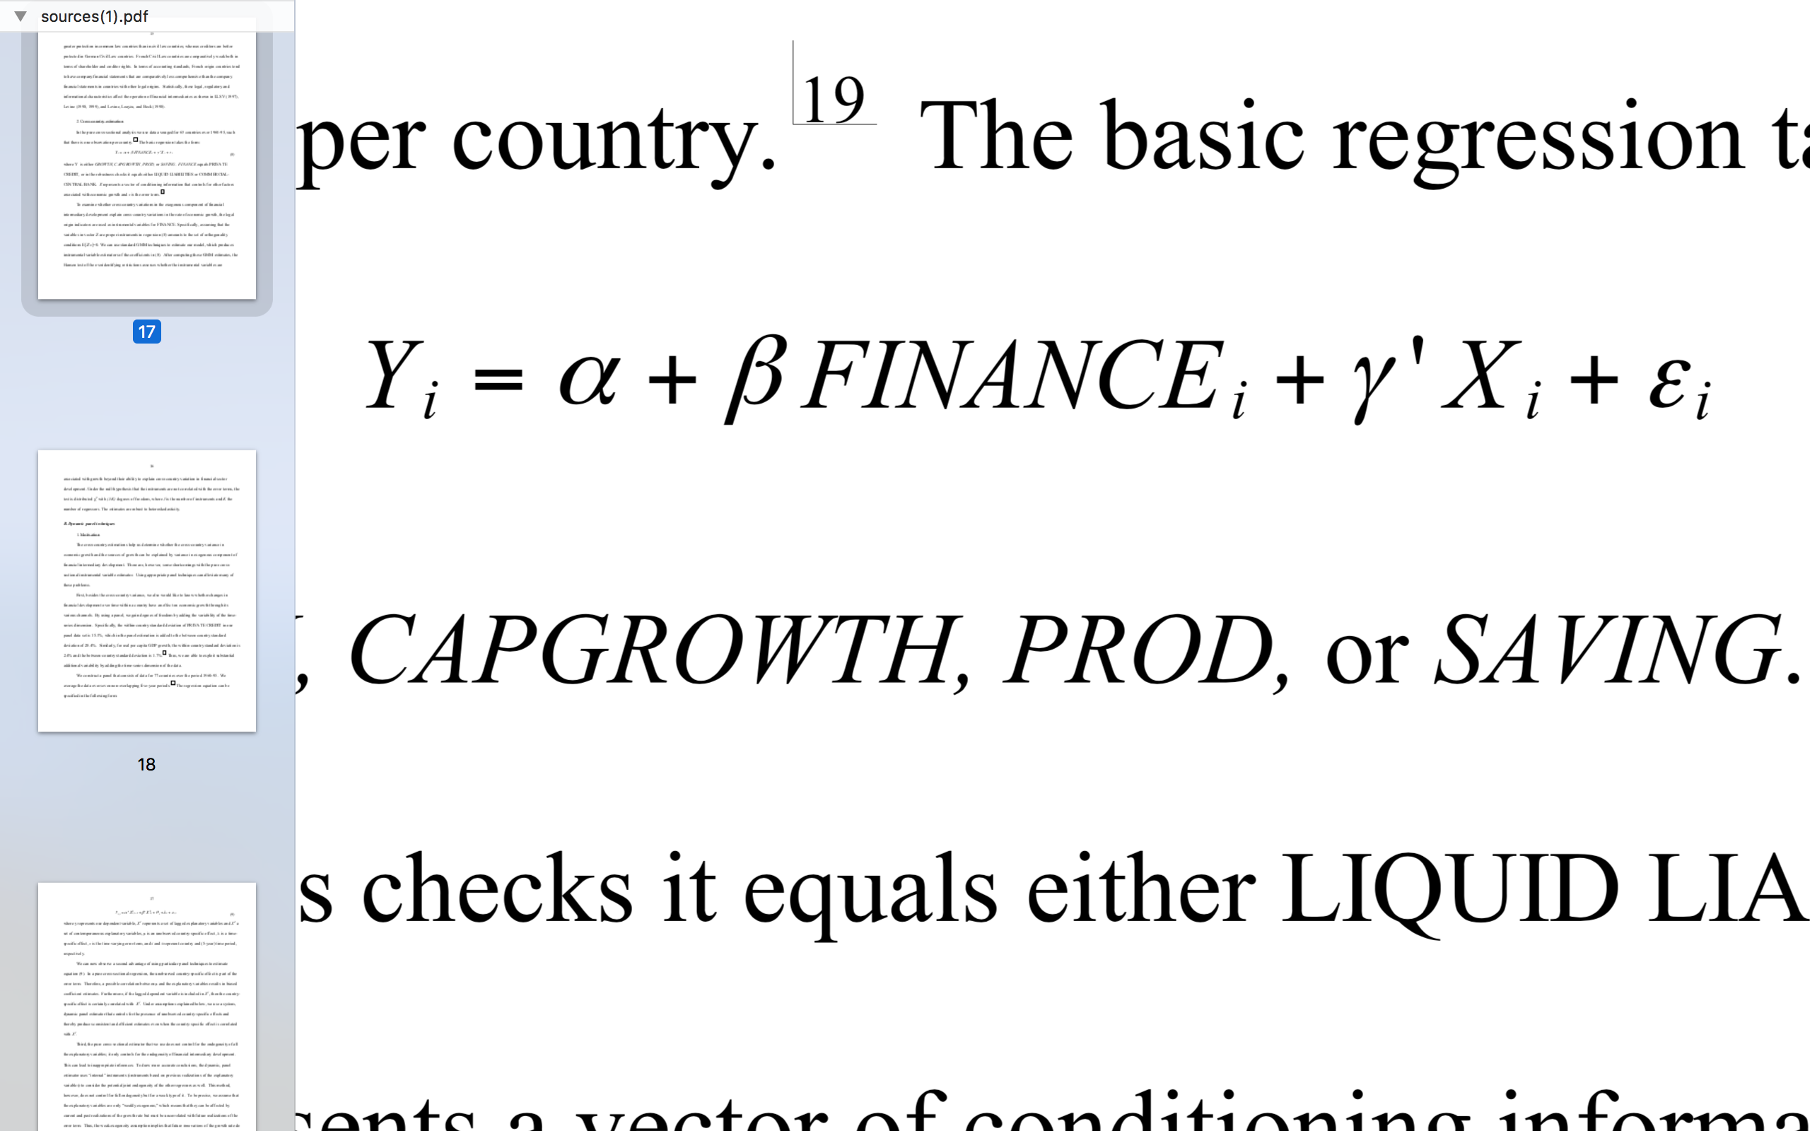
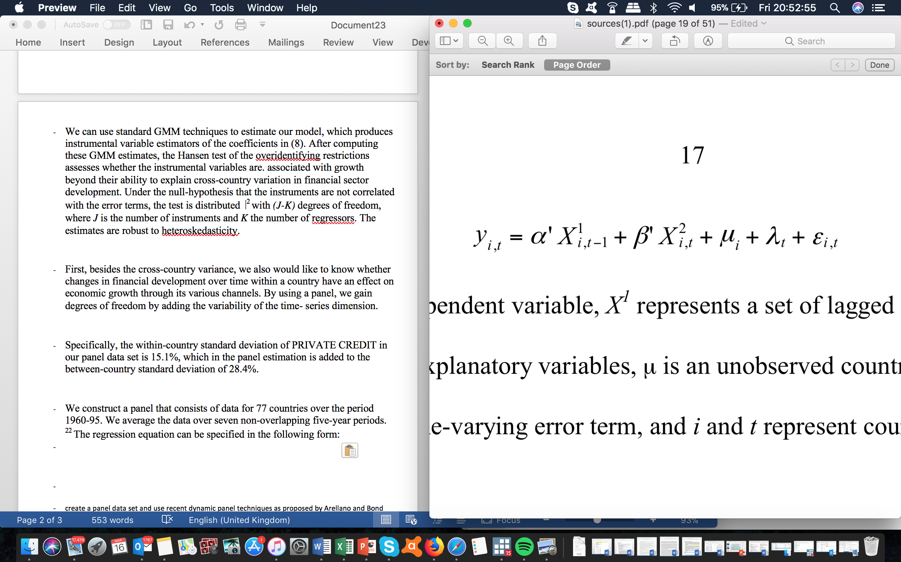
Methodology - Models
OLS regression
Two-step GMM estimator
Y: Growth, Capgrowth, Prod, Saving.
Control Factors: FINANCE = PRIVATE CREDIT
X variables: represents a vector of conditioning information that controls for other factors associated with economic growth and ε is the error term.
Y: Growth, Capgrowth, Prod, Saving.
Control Factors: FINANCE = PRIVATE CREDIT
X variables: set of lagged explanatory variables
X²: a set of contemporaneous explanatory variables
μ: an unobserved country-specific effect
λ: a time- specific effect
ε: time-varying error term, and i and t represent country and (5-year) time period, respectively.

Slide 10
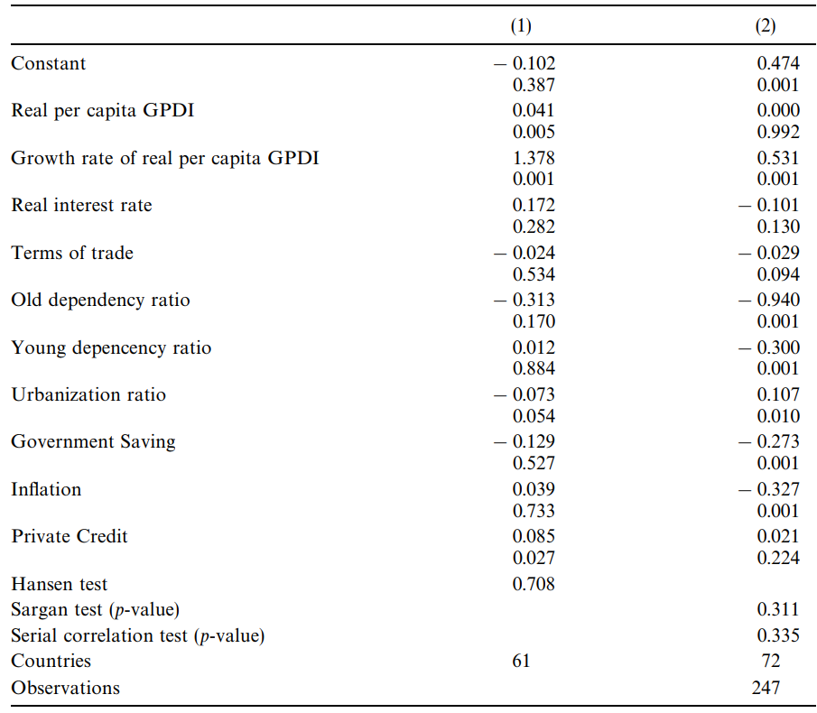
Results
Results show a positive and statistically significant effect of financial development on real GDP growth.
A positive relationship between financial development and total factor productivity growth exists
However…..inconclusive evidence that financial development has any affect on physical capital accumulation or private saving rates.
Results support the idea that financial development has a positive effect on economic growth via improvements in productivity growth rather than capital accumulation.

Slide 11
What is the channel through which financial development affects economic growth?
NOW……….WE ASK YOU

Slide 12
Discuss the causal relationship between financial development and economic growth.
FINANCIAL DEVELOPENT GIVES BETTER CHANNELS FOR INVESTMENTS
COMSUMERS + FIRMS HAVE BETTER ACCESS LOANS → INCREASES MPC BECAUSE INTREST RATESMAY BE MORE ATRACTIVE
→ WILL BOST DEMAND IN THE ECONOMY →
BOOSTING ECONOMIC GROWTH
HIGHER GDP PER CAPITA LIKELY TO INCREASE MPS -→
SAVINGS WILL INCREASE -→ ALLOWING FOR ACCELETOR EFFECT -→ A FURTHER INCREASE IN DEMAND

